Slide 1
Buprenorphine and Overdoses
Frank LoVecchio, DO, MPH, FACEP
Professor, Research Scholar, Emergency Medicine, Addiction, Medicine, Medical Toxicology, University of Arizona, ASU, Creighton, Midwestern, Colleges of Medicine

Slide 2
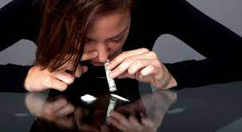
Case 1
27-year-old male
History OUD (snorts fentanyl), last used about 72 hours ago, starting to feel withdrawals
Temp 98.6F, P 91, BP 132/84, RR 18, 99% on RA

Slide 3
COWS Element | COWS Score
HR 81-100 | 1
Appears flushed | 2
Difficulty sitting still, but able to do so | 1
Pupils possibly larger than normal for room light | 1
Mild diffuse discomfort | 1
Rhinorrhea/tearing | 2
Nausea/loose stool | 2
Slight observable tremor | 2
Yawning 1-2 times during assessment | 1
Increasing irritability or anxiousness | 1
Skin is smooth | 0
Total | 14
Notes:
***Put into table format
Exam/COWS score of 12
Prior lecture covering COWS score?

Slide 4
Medication Plan
Nothing
Supportive Medications Only
Medication-assisted treatment (MAT)

Slide 5
Trends and Characteristics of Buprenorphine-Involved Overdose Deaths Prior to and During the COVID-19 Pandemic
Tanz LJ, Jones CM, Davis NL, Compton WM, Baldwin GT, Han B, Volkow ND. Trends and Characteristics of Buprenorphine-Involved Overdose Deaths Prior to and During the COVID-19 Pandemic. JAMA Netw Open. 2023 Jan 3;6(1):e2251856. doi: 10.1001/jamanetworkopen.2022.51856. PMID: 36662523; PMCID: PMC9860517.

Slide 6
Characterization of Unintentional Deaths Among Buprenorphine Users
Among 11,764 drug-related deaths, only 564 (4.8%) involved buprenorphine.
Buprenorphine alone was present in 32 deaths, of which 20 were considered the direct cause of death (0.2% of all drug-related deaths).
Significantly more BIDs involved five or more drugs (23%) compared with other opioid deaths (14.9%).
Co-intoxicants found most frequently in BIDs were benzodiazepines (47.3%), methamphetamine (27.1%), and fentanyl (22.9%).
Of the 564 BIDs, a current buprenorphine prescription was present in 132 deaths (23.4%).
Dai Z, Limen GN, Abate MA, Kraner JC, Mock AR, Smith GS. Characterization of Unintentional Deaths Among Buprenorphine Users. J Stud Alcohol Drugs. 2023 Jan;84(1):171-179. doi: 10.15288/jsad.22-00049.

Slide 7
Notes:
Dog sledding is part of everyday life in icy Greenland

Slide 8
Which is False?
Prescribing buprenorphine for opioid use disorder (OUD) replaces one addiction for another
A commitment to abstinence will prevent opioid overdose more than buprenorphine will
Buprenorphine can be misused and, therefore, prescribers should strictly control access
Prescribing buprenorphine comes with more legal liability than prescribing other medications, or will make the Drug Enforcement Administration (DEA) target the prescriber or practice
A person must be completely abstinent and have a completely negative urine screen to receive buprenorphine
The ideal length of treatment with buprenorphine is six months or less. Treatment success means patients will become drug-free, including from buprenorphine and methadone
Outpatient therapy or counseling is mandatory for clinical improvement

Slide 9
Buprenorphine
Long-acting synthetic opioid, mu receptor partial agonist
Prevents withdrawal without having the strong euphoric or respiratory effects of a full opioid agonist
Buprenorphine + naloxone = Suboxone
Elimination of the X-Waiver increases the number of potential buprenorphine prescribers from 130,000 to 1.8 million
“Because of buprenorphine’s opioid effects, it can be misused, particularly by people who do not have an opioid dependency. Naloxone is added to buprenorphine to decrease the likelihood of diversion and misuse of the combination drug product. When these products are taken as sublingual tablets, buprenorphine’s opioid effects dominate naloxone and blocks opioid withdrawals. If the sublingual tablets are crushed and injected, however, the naloxone effect dominates and can bring on opioid withdrawals ” SANMSA, June 15, 2019
Notes:
Long-acting synthetic opioid, mu receptor partial agonist
By partially binding the opioid receptors, it prevents withdrawal without having the strong euphoric or respiratory effects of a full opioid agonist, such as heroin, fentanyl or even methadone
Combination with naloxone as Suboxone does not cause withdrawal, but is designed to prevent diversion and misuse of the medication
Previously, required an “X-waiver” from the DEA to prescribe. This is no longer required. Anyone with an active DEA number can prescribe buprenorphine or Suboxone
Thomas CP, Fullerton CA, Kim M, Montejano L, Lyman DR, Dougherty RH, Daniels AS, Ghose SS, Delphin-Rittmon ME. Medication-assisted treatment with buprenorphine: assessing the evidence. Psychiatr Serv. 2014 Feb 1;65(2):158-70. doi: 10.1176/appi.ps.201300256. PMID: 24247147.

Slide 10
Buprenorphine Works!
Efficiently alleviates withdrawal symptoms
Lowers mortality from opioid use disorder
5% of ED patients with an opioid OD requiring naloxone die within 1 year
Buprenorphine reduces that risk by 62%
Doubles likelihood of a patient remaining in treatment at one month
Notes:
Smart art blocks instead?
Why is it good for treating opioid use disorder, especially in the acute care setting … because it works!
Efficiently alleviates withdrawal symptoms
5% of ED patients with an opioid OD requiring naloxone die within 1 year
Lowers mortality from opioid use disorder
Buprenorphine treatment after nonfatal opioid-involved overdose was associated with a 62% reduction in the risk of opioid-involved overdose death (Samples H, Nowels MA, Williams AR, Olfson M, Crystal S. Buprenorphine After Nonfatal Opioid Overdose: Reduced Mortality Risk in Medicare Disability Beneficiaries. Am J Prev Med. 2023 Mar 9:S0749-3797(23)00052-1. doi: 10.1016/j.amepre.2023.01.037. Epub ahead of print. PMID: 36906496.)
Buprenorphine was associated with decreased all-cause mortality (adjusted hazard ratio, 0.63 [CI, 0.46 to 0.87]) and opioid-related mortality (AHR, 0.62 [CI, 0.41 to 0.92]). (Larochelle MR, Bernson D, Land T, Stopka TJ, Wang N, Xuan Z, Bagley SM, Liebschutz JM, Walley AY. Medication for Opioid Use Disorder After Nonfatal Opioid Overdose and Association With Mortality: A Cohort Study. Ann Intern Med. 2018 Aug 7;169(3):137-145. doi: 10.7326/M17-3107. Epub 2018 Jun 19. PMID: 29913516; PMCID: PMC6387681.)
Doubles likelihood of a patient remaining in treatment at one month
Better follow up for patients treated with bup (78 vs 37%, D’Onofrio)

Slide 11
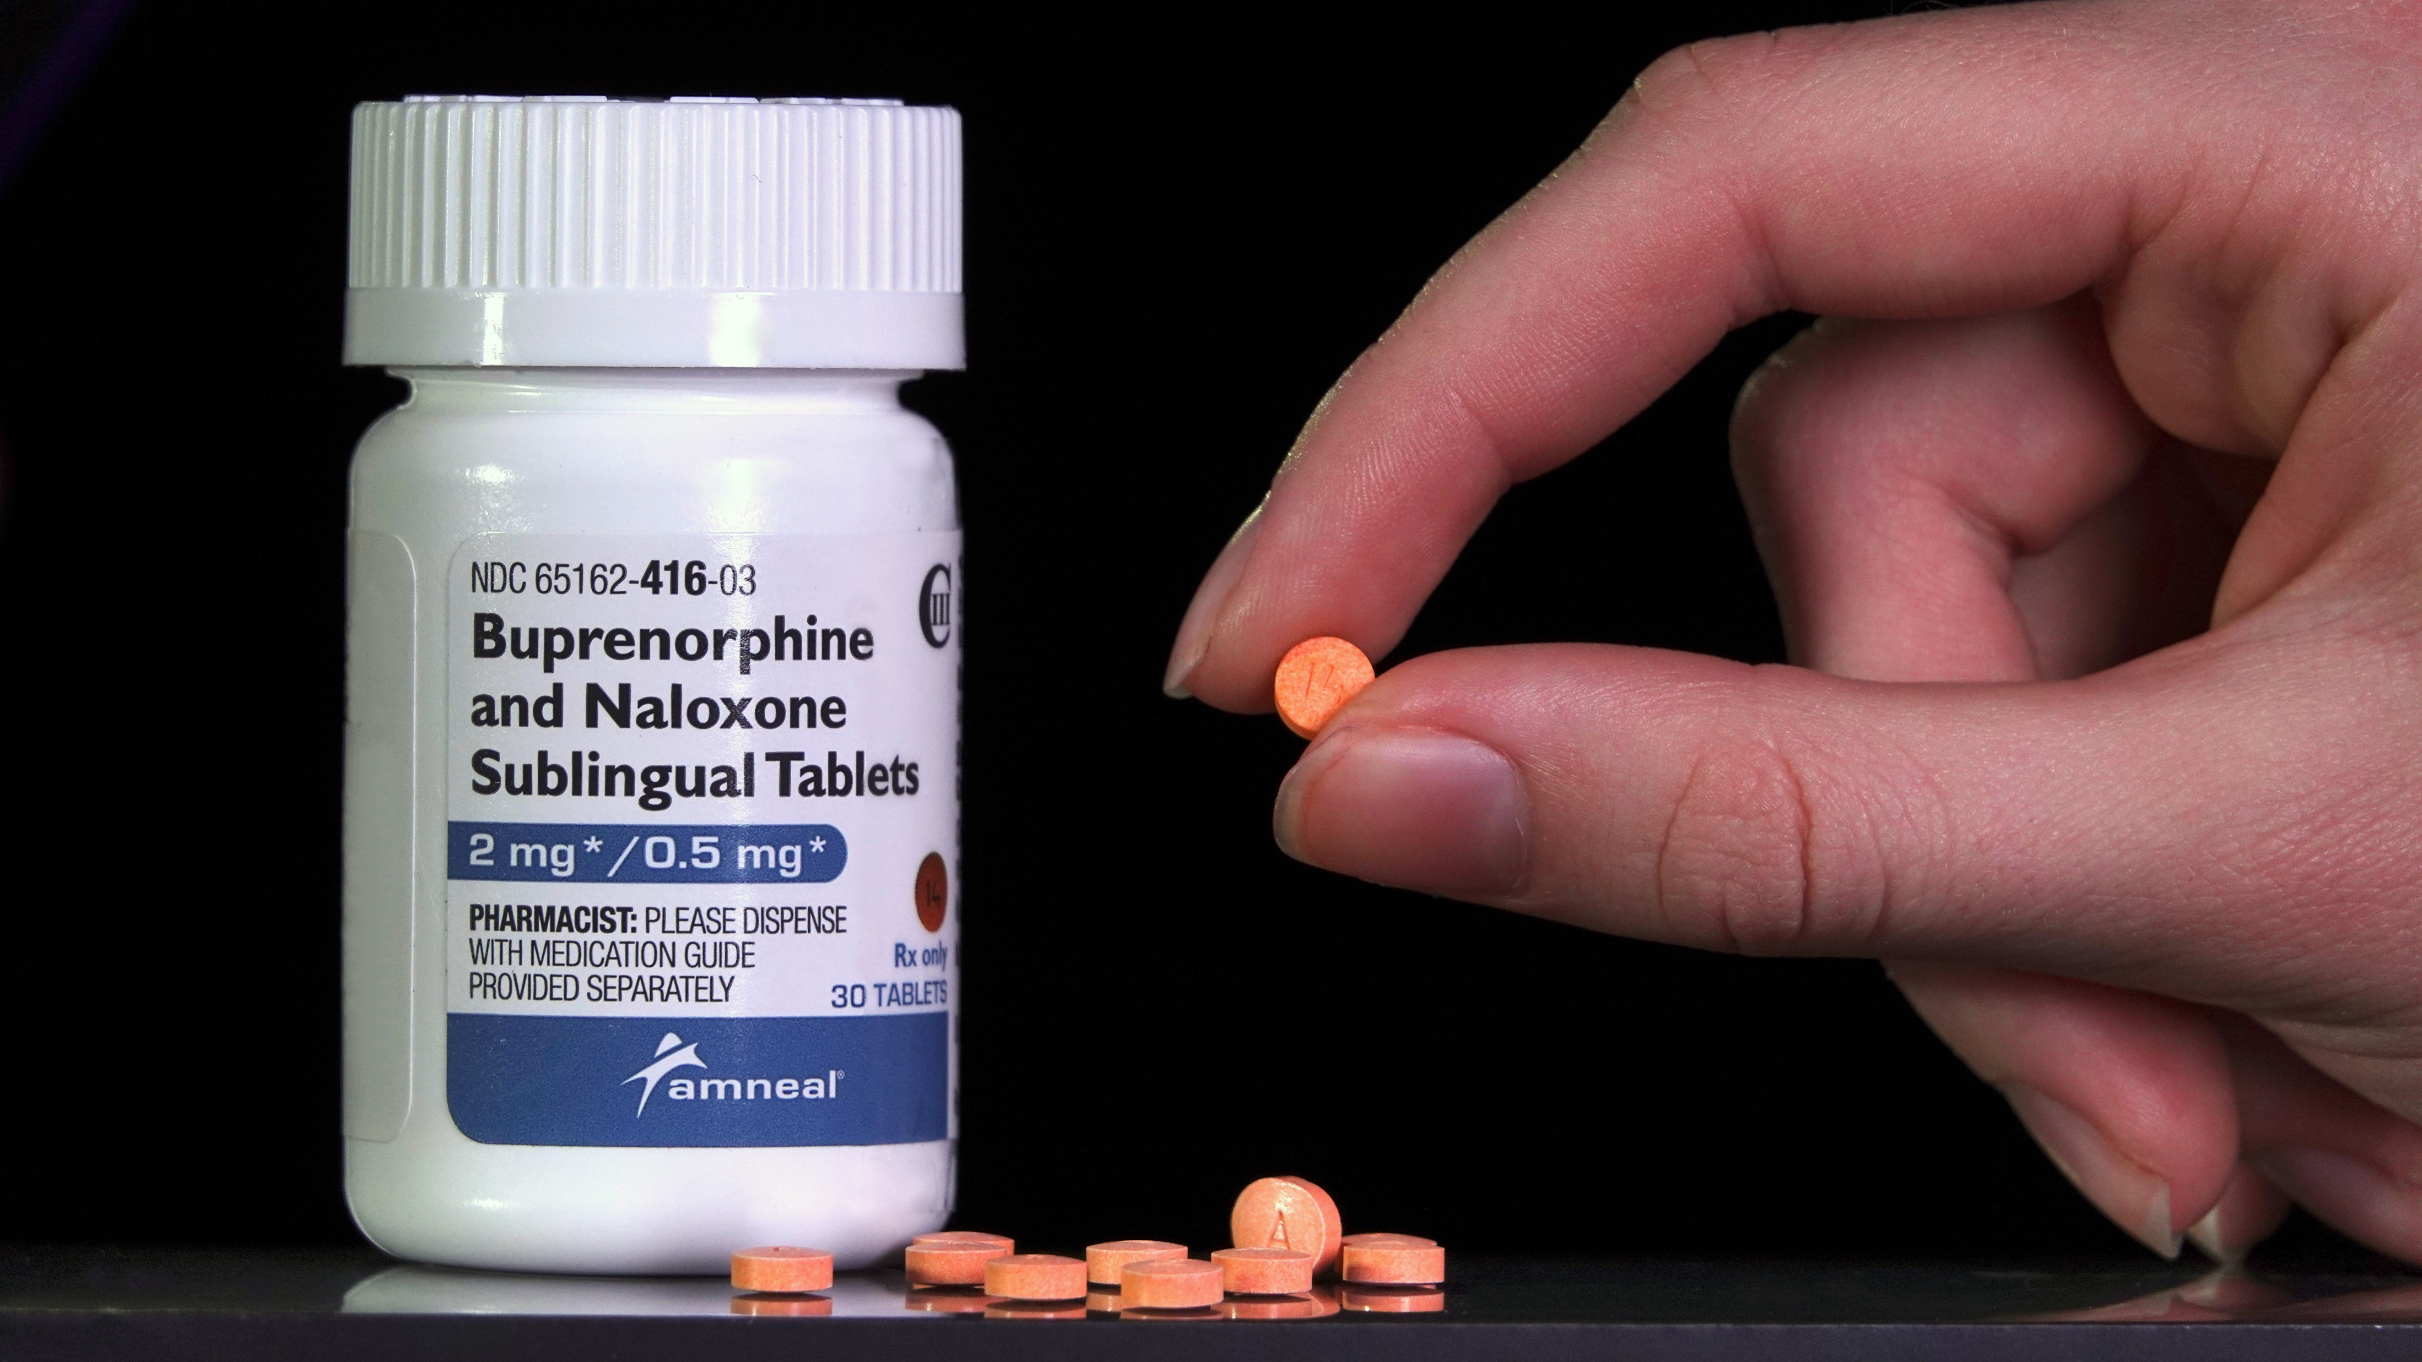
Buprenorphine is Practical
Works quickly
No lab testing needed
Can give it to patients who just got naloxone
Has been shown to be cost effective
Buprenorphine induction is a billable procedure
Defendable
Notes:
No lab testing required- not renally cleared, so don’t need to check Cr
Can give it to patients who were just given naloxone for opioid overdose (as long as not altered, intoxicated, use methadone, otherwise severely ill)

Slide 12
Who to Give Buprenorphine
Opioid users in withdrawal
COWS score > 8-10
And/or at least 2 objective signs of withdrawal
Also:
Not altered
Not intoxicated
Not using methadone (within 72 hours but really anytime recently)
Has not used fentanyl within 12 hours
Notes:
COWS assessment score
> or = 8
Not altered, not intoxicated is not using methadone (within 72 hours but really anytime recently) or fentanyl within 12 hours
In our patient, he gets a 12 for moderate withdrawal
Mention 2 objective signs of withdrawal
Patients must already be in withdrawal before we give them buprenorphine, otherwise we can precipitate withdrawal..
Ex: If exhibiting 2 signs (such as appearing flushed, yawning, vomiting, or tremoring → makes precipitated withdrawal less likely. We’ll talk more about precipitated withdrawal later
No lab tests needed – buprenorphine is not renally metabolized

Slide 13
COWS score 12
Buprenorphine 8-16 mg SL
Wait 30-60 minutes
Second dose of 8-16 mg
Establish follow up in 72 hours
Prescribe buprenorphine/naloxone 8/2mg strips, 2 strips SL QD x7d
Prescribe/give take home naloxone nasal spray, 1 actuation q3 min prn
Back to the Case
Notes:
***Make into flow chart
First dose: Buprenorphine 8-16 mg SL
A bit of subjectivity for how much to start with
Going to low (like 2 mg or 4 mg), might not be enough for the patient
Onset is 15-30 minutes, peak at 1 hour
Wait/reassess
30-60 minutes
If improved, give second dose: Buprenorphine 8-16 mg SL
If not improved, consider that something else might be causing the patient’s symptoms besides opioid withdrawal
Follow up within 72 hours
Prescription for follow up:
Buprenorphine/naloxone 8/2mg strips, 2 strips SL QD x7d
Take home/OTC: Naloxone nasal spray, 1 actuation q3 min prn

Slide 14
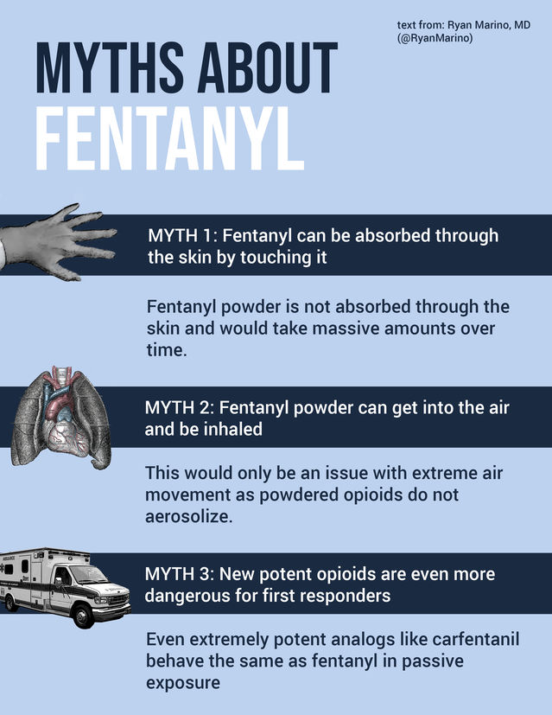
Case 2 (1)
33-year-old female
History OUD (snorts fentanyl), last used last night, starting to feel withdrawals
Temp 98.6F, P 81, BP 128/80, RR 18, 99% on RA

Slide 15
Case 2 (2)
Exam:
HR 81-100,
subjective report of chills or flushing,
reports difficulty sitting still but is able to do so,
pupils normal in size,
reports mild diffuse discomfort, nasal stuffiness or unusually moist eyes,
reports stomach cramps,
tremor can be felt but not observed,
no yawning during assessment,
patient reports increasing irritability or anxiousness, skin is smooth →
COWS 8, mild withdrawal
Notes:
*** make into table

Slide 16
COWS Element | COWS Score
HR 81-100 | 1
Subjective report of chills or flushing | 1
Difficulty sitting still, but able to do so | 1
Pupils normal size | 0
Mild diffuse discomfort | 1
Nasal stuffiness | 1
Stomach cramps | 1
No tremor | 0
No yawning | 0
Increasing irritability or anxiousness | 1
Skin is smooth | 0
Total | 7
Case 2
Notes:
*** make into table

Slide 17
COWS = 7 → mild withdrawal
Buprenorphine 4 mg
Patient feels worse
Recalculate COWS, now = 18
Precipitated withdrawal
Case 2 (3)
Notes:
(as a note of practicality, nurses are more than capable of calculating and documenting the COWS, but as a clinician, you should also understand and be able to calculate the score)
Low ish for this patient
And not really having objective signs of withdrawal
We give a small dose of buprenorphine – 4 mg
Gets worse, higher COWS score
Precipitated withdrawal
When you give a partial agonist (such as buprenorphine) to a patient who still has a full agonist (heroin, fentanyl, methadone) still in their system
Increase in COWS score by >= 5 within 1 hour of starting bup

Slide 18
Preventing Precipitated Withdrawal
Make sure patients are well into opioid withdrawal
At least 2 objective signs of withdrawal
COWS > or = 8
At least 12 hours after last fentanyl use
At least 72 hours after last methadone use*
Home start or outpatient as alternative
Notes:
Have them come back to ED when in withdrawal
Home start
SAMHSA has a home start guide
Microdosing* - difficult for most patients
Follow up
Adjuncts prior to bup
Clonidine 0.3 mg QID
Ondansetron 4 mg q4h prn
NSAIDs
Loperamide 4 g PO q4h
Gabapentin 900 mg TID
Baclofen 20 mg TID
Trazodone 100 mg QHS

Slide 19
Treating Precipitated Withdrawal (1)
Give buprenorphine 16 mg SL
+/- lorazepam 1-2 mg PO
Reassess
COWS < 8 → offer additional buprenorphine 8-16 mg, give Rx
If not better or if worse, give buprenorphine 8-16 mg SL + ketamine 0.3 mg/kg slow IV push (can repeat q30 minutes x 3) → discharge with Rx
If still not improved, consider fentanyl 200 mg IV q10 min x4 doses, ketamine infusion, admission
Notes:
***Make into flow diagram
Avoid reglan or other dopamine antagonists
Probably will not improve all symptoms prior to discharge

Slide 20
Treating Precipitated Withdrawal (2)
Buprenorphine 16 mg SL
+/- lorazepam 1-2 mg PO
Ibuprofen
Clonidine
Gabapentin
Baclofen
Pramipexole
Loperamide
Ondansetron
Trazodone
+/-
Reassess
COWS > or = 8
COWS < 8
Buprenorphine 8-16 mg SL
Ketamine 0.3 mg/kg slow IV push (q30 minutes x 3 prn)
Offer additional Buprenorphine 8-16 mg, discharge with Bup Rx
Discharge with Bup Rx
Inpatient or ICU admission
Discharge with Bup Rx
If still not improved, consider fentanyl 200 mg IV q10 min x4 doses, ketamine infusion, admission
Notes:
***Make into flow diagram
Avoid reglan or other dopamine antagonists
Probably will not improve all symptoms prior to discharge

Slide 21
Motivational interviewing
Open ended questions
Partnership
Acceptance
Compassion
Evocation
Patients are more likely to be persuaded by what they hear THEMSELVES say…Not what they hear someone else ‘tell’ them
Notes:
The style or spirit of MI described by miller and rollnick includings
Partnership and collaboration, instead of confrontation
Acceptance of pt, vs judgement.
Compassion practitioner actively prioritizes clients’ welfare and wellbeing in a selfless manner.
Evocation of what already exists within the patient - instead of expert “education” or advice giving

