Slide 1
Medication for Opioid use disorder (moud) treatment of stimulant use disorder
Michael E Sheehy, DO, FACOEP, FACEP emergency/addiction Medicine

Slide 2
Disclosures
I have nothing to disclose.

Slide 3
Objectives of lecture
Diagnosing Opioid Use Disorders (OUD)
Diagnosing opioid withdrawal syndrome
Medications for Opioid Use Disorder (MOUD)
Treatment of Stimulant Overdose (Overamping) and Stimulant Use disorder
Nitazines the new drug on the block

Slide 4
Why offer MOUD In the ED
⍰
Notes:
Decreases mortality
Decreases patient initiated discharges (leaving AMA)
Improves medical care for patients with SUD
Decreases bounce backs
Improved patient satisfaction
Rewarding for you as a provider

Slide 5
Diagnosing Opioid use disorder
The diagnosis of substance use disorder is based on the presence of at least 2 of 11 criteria.
The criteria are divided into four groups:
Group 1: Impaired control
Group 2: Social impairment
Group 3: Risky use
Group 4: Pharmacologic dependence
Notes:
Taking the substance in larger amounts or for longer than you're meant to
Wanting to cut down or stop using the substance but not managing to
Spending a lot of time getting, using, or recovering from use of the substance
Cravings and urges to use the substance
Not managing to do what you should at work, home, or school because of substance use
Continuing to use, even when it causes problems in relationships
Giving up important social, occupational, or recreational activities because of substance use
Using substances again and again, even when it puts you in danger
Continuing to use, even when you know you have a physical or psychological problem that could have been caused or made worse by the substance
Needing more of the substance to get the effect you want (tolerance)
Development of withdrawal symptoms, which can be relieved by taking more of the substance

Slide 6
Diagnosing Opioid Withdrawal syndrome
By history patient found down and given Naloxone in the field and now in precipitated withdrawal.
Ran out of prescription opioids.
Opioid source unavailable or lacks finances to obtain illicit opioids.

Slide 7
Other history
Quantify daily use: drug/dose/route/frequency.
The clinician should also elicit historical factors that may place the patient at higher risk from complications from opioid withdrawal such as
Comorbid coronary artery disease
Chronic kidney disease
Diabetes mellitus
Hepatic failure
Alcohol/sedative-hypnotic withdrawal
Epilepsy

Slide 8
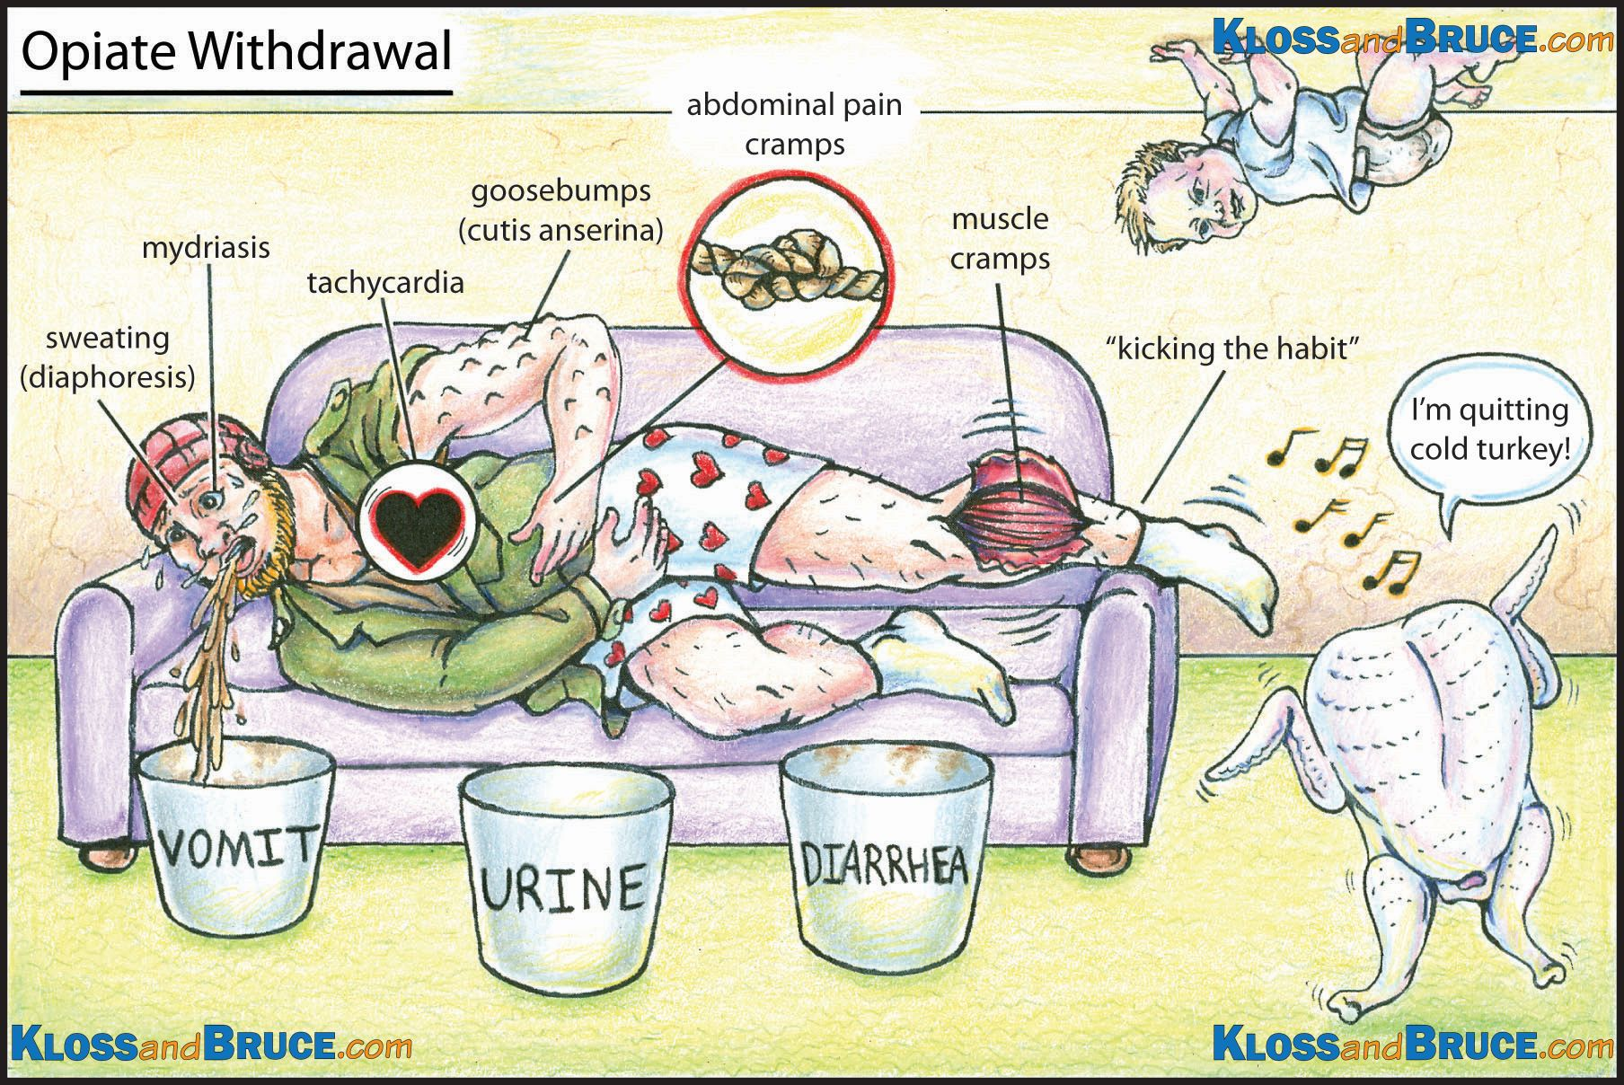
Notes:
Clinically – Anxiety,
goosebumps,
restlessness,
insomnia,
yawning,
runny nose,
watery eyes,
widened (dilated) pupils,
body aches,
sweating,
vomiting,
abdominal cramps,
diarrhea,
fever,
shaking,
tachycardia,
rapid breathing,
elevated blood pressure,
hallucinations, seizures.

Slide 9
Clinical Opiate withdrawal Scale (COWS)
COWS is an 11-item scale.
Can be used in both inpatient and outpatient settings.
To reproducibly rate common signs and symptoms of opiate withdrawal and monitor these symptoms over time.
The summed score for the complete scale can be used to help clinicians determine the stage or severity of opiate withdrawal.

Slide 10
COWS
Variables assessed
Resting pulse, Sweating, Degree of restlessness, Pupil size, Bone or joint aches, Rhinorrhea or tearing, GI upset, Tremor, Yawning, Anxiety or irritability, Gooseflesh skin.
Interpretation based on answers:
No active opiate withdrawal -0-4
mild opiate withdrawal - 5–12
moderate opiate withdrawal – 13-24
moderately severe opiate withdrawal – 25-36
severe opiate withdrawal – greater than 36

Slide 11
Subjective Opiate withdrawal scale (sows)
The SOWS is a self-administered scale for grading opioid withdrawal symptoms.
It contains 16 symptoms whose intensity the patient rates on a scale of 0 (not at all) to 4 (extremely), and takes less than 10 minutes to complete.
British Columbia Centre on Substance Use
Notes:
Patient’s can use this at home if not in enough withdrawal to initiate in the ED and can use the score to determine when in enough withdrawal to start a standard dose buprenorphine induction.

Slide 12
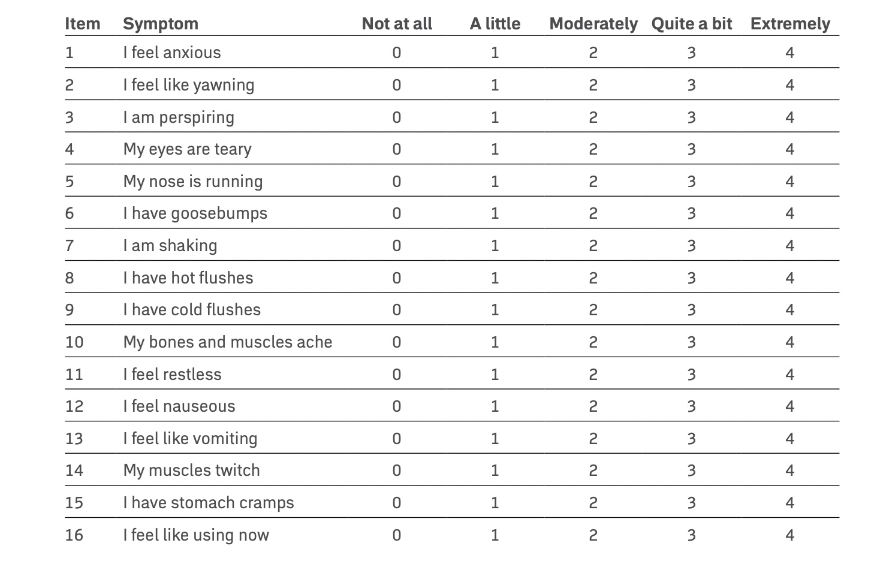
Handelsman L, Cochrane KJ, Aronson MJ, Ness R, Rubinstein KJ, Kanof PD. Two New Rating Scales for Opiate Withdrawal. 1987. American Journal of Alcohol Abuse 13, 293-308.
Notes:
Mild Withdrawal = score of 1 – 10 Moderate withdrawal = 11 – 20 Severe withdrawal = 21 – 30

Slide 13
Symptomatic treatment
Initiate symptom-targeted treatments
Antiemetics
Ondansetron 4 mg IV/PO q6h prn
Promethazine 6.25-25 mg IVPB/IM/PR/PO
Beware prolonged QTc, especially with methadone or hypokalemia/hypomagnesemia
Antispasmodics
Dicyclomine 10-20 mg PO q12h prn
Notes:
Remember that while opioid withdrawal is not life threatening like alcohol or benzodiazepines, it is incredibly uncomfortable so while during whether the patient is a candidate for MOUD treat their symptoms of withdrawal.
This will decrease their self initiated discharges, less their discomfort, build trust with medical system, make it easier to care for the patient, allow them to make informed decisions.

Slide 14
Symptomatic treatments
Analgesics
Acetaminophen 650-1,000 mg PO/IV q6h prn
Ketorolac 15 mg IV q6h prn
Ibuprofen 600-800 mg PO q8h prn
Though not a true analgesic, gabapentin can be used as an adjunctive therapy at a dose of 300 mg PO q8-12h

Slide 15
Symptomatic treatment
Antidiarrheal
loperamide 2-4 mg PO initially, then 2 mg PO q4h prn
Centrally acting alpha-2 agonists
Clonidine 0.1-0.2 mg PO q6-8h, or
Clonidine transdermal patch 0.1 mg/24 h, or
Lofexidine 0.54 mg PO q6h for the first week then tapered for a maximum of 14 d of use

Slide 16
Symptomatic treatment
Anxiolytics
Hydroxyzine 25-50 mg PO/IM q6-8h prn, or
Benzodiazepines should be used with caution if at all in the ED and prescriptions are not recommended
Lorazepam 0.5-2 mg IV/IM/PO q1-4 prn

Slide 17
Symptomatic treatment
Insomnia
Doxepin 3 mg PO q24h at bedtime, may increase to 6 mg if needed
Quetiapine 25-100 mg PO q24h at bedtime
Trazodone 50-100 mg PO PO q24h 1 h before bedtime
Muscle relaxers
Baclofen 5 mg PO q8h

Slide 18
Symptomatic treatment
Consider the administration of a multivitamin, thiamine, and folate if the patient co-uses ethanol.
Evaluate for and treat co-occurring medical/psychiatric/traumatic illnesses.
If the patient screens positive for opioid use disorder, is in withdrawal, and is ready to make a change, then he/she may be a candidate for ED-initiated MOUD.

Slide 19
Medications for opioid use disorder (moud)
Three FDA approved medications treating OUD
Buprenorphine
Methadone
Naltrexone (preferably extended release IM formulation)

Slide 20
Buprenorphine
Buprenorphine is a partial agonist with high receptor affinity.
Buprenorphine has a 15-30 min onset with peak effect at 1-4 h.
Due to its low intrinsic receptor activity, there is a ceiling effect with respect to somnolence and respiratory depression.
It has a dose-dependent duration of action due to its slow release from the mu receptor.
This means a single large dose of buprenorphine can safely occupy and partially activate the mu receptor protecting the patient from insults by full agonists while incurring essentially no risk of respiratory depression or somnolence unless the co-ingestion of alcohol or sedative-hypnotics occurs.
Notes:
Buprenorphine is a lifesaving medication for opioid use disorder that reduces mortality by 50%!!!
Buprenorphine is a mu-opioid receptor partial agonist with a ceiling effect, so it is less likely to cause an overdose than full opioid agonists.
There is no longer a training requirement to prescribe buprenorphine in the clinic. The only requirement is completing short notice of intent with SAMHSA (DATA waiver application).
Patients can start buprenorphine on their own at home; asking a patient to physically start the medication while in the ED is not necessary.

Slide 21
Buprenorphine initiation
Standard buprenorphine induction (Traditional).
Low dose cross taper induction.
High dose buprenorphine induction.
Extended release buprenorphine injection
Notes:
No labs are needed prior to starting buprenorphine.
A urine drug screen can be helpful but should not delay the start of medication.
Most urine drug screens do not test for fentanyl – find out if you need to order this separately at your institution and be aware that this test may take longer to result.
A pregnancy test is not necessary (unless requested by the patient) because buprenorphine is safe and recommended (ACOG 2021) in pregnancy.

Slide 22
Standard induction
Traditional buprenorphine starts involve stopping the full agonist opioid and waiting for generally moderate withdrawal symptoms before taking the first dose of buprenorphine.
With short acting full agonist opioids such as oxycodone, morphine, hydrocodone, about 8-12 hours.
For longer acting medications such as Methadone or High Potency Synthetic Opioids (HPSO) 72 hour plus.

Slide 23
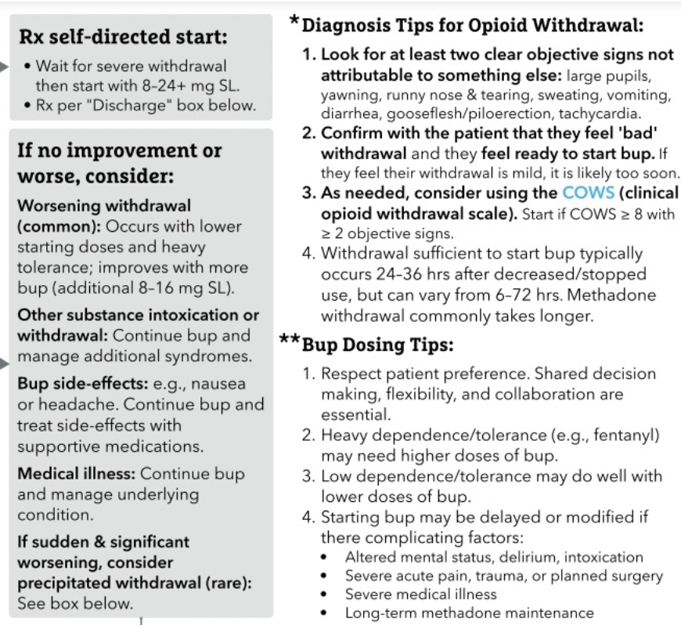
Standard induction

Slide 24
Low dose induction
In patients who are unable to stop full opioid agonists, such as individuals being treated for acute pain, low-dose initiation of buprenorphine is another option to avoid periods of withdrawal.
Using this low-dose approach, low doses of buprenorphine are administered and slowly increased each day while the full opioid agonist is continued.
Notes:
Fentanyl is lipophilic, and individuals with heavy, regular use who want to start buprenorphine may need to wait longer periods (> 24 hours) before initiating their first dose to decrease the risk of precipitated withdrawal.
Low-dose buprenorphine starts generally occur over 4 – 7 days: Slowly introducing buprenorphine while continuing the full-agonist opioid allows individuals to transition to buprenorphine without experiencing severe withdrawal.
Low-dose buprenorphine starts may work well for patients who have previously experienced precipitated withdrawal, have acute pain management needs, or have not successfully transitioned to buprenorphine using traditional protocols.
Be sure to counsel patients that you will manage their withdrawal and cravings during the low-dose process, as well as explain the rationale behind the protocol
Many different low-dose protocols can be used in the hospital and outpatient setting. Check with the hospital formulary to see which buprenorphine products are available for use.
In the outpatient setting, due to regulations, most patients will need to cut sublingual films or tabs of buprenorphine for the low-dose protocols.
If an individual is having challenges with the low-dose protocol, consider slowing down the protocol (e.g., repeating a day) or consider increasing the full agonist opioid.
In the outpatient setting, try to provide patients with written instructions, and provide frequent touch-points.

Slide 25
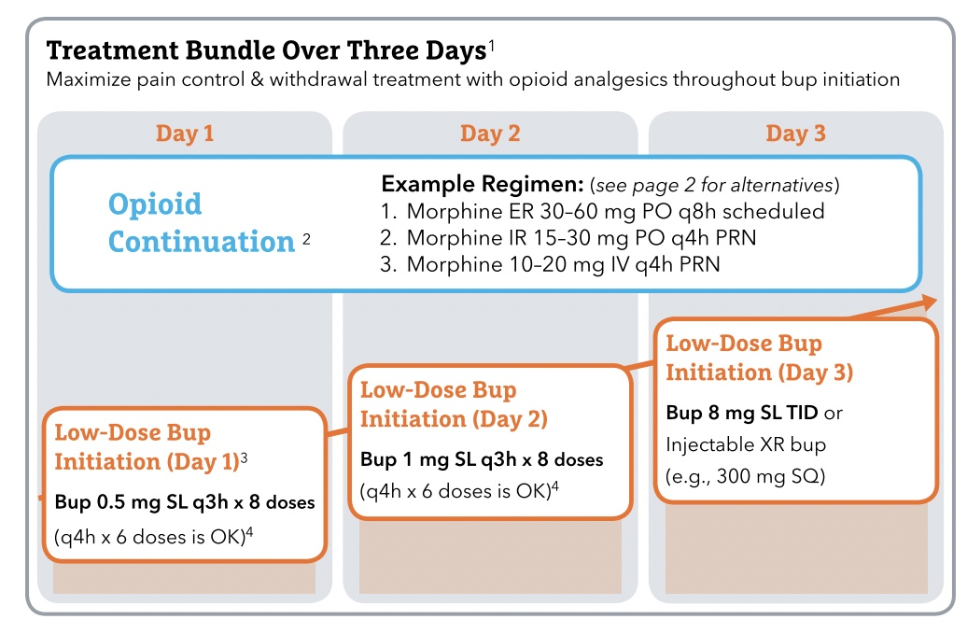

Slide 26
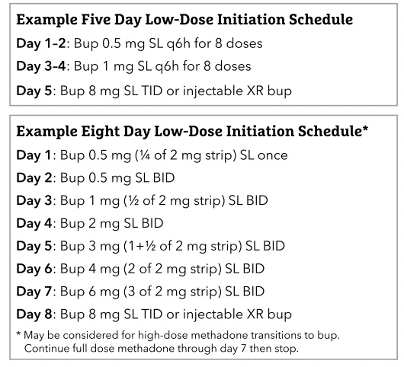

Slide 27
High dose induction
High-dose buprenorphine start, is a variation of traditional initiation in which higher doses of buprenorphine are used with each dose.
This adaptation can be considered as a means to align buprenorphine initiations with the heightened opioid tolerance that develops through regular HPSO use.

Slide 28
High dose induction
The process still involves stopping all opioids and waiting for significant symptoms of opioid withdrawal (COWS >8 with objective signs of opioid withdrawal) prior to starting buprenorphine (Herring 2021, Snyder 2023).
In recommends patients wait at least 48 hours following the last HPSO use and for at least one objective sign of opioid withdrawal (e,g,, mydriasis or piloerection) before starting buprenorphine.
At that point, 8-16mg of buprenorphine is given and repeated every 2 hours to a maximum of 24-32 mg of buprenorphine on the first day.

Slide 29
High dose induction
This method is useful in cases of patients presenting to the ED after opioid withdrawal inducted by Naloxone given in the field due to overdose.

Slide 30
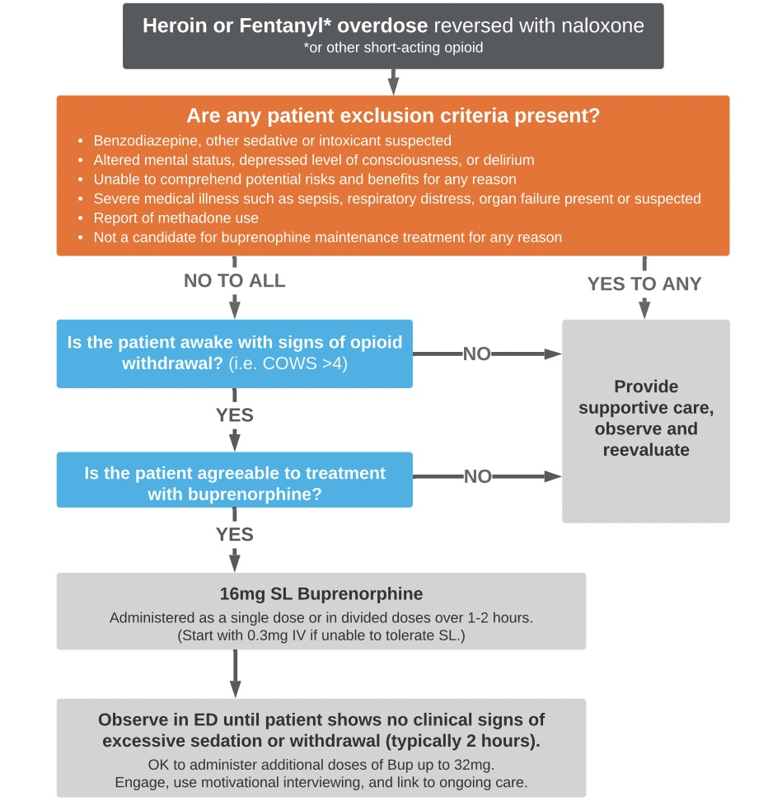

Slide 31
Injectable buprenorphine for induction
In patients in mild withdrawal COWS of 4-7 there is one non randomized study that shows minimal adverse reactions and good results with an injection of a 7 day extended release formulation of buprenorphine (Brixadi®️).
This will allow faster induction, minimal risk of buprenorphine induced precipitated withdrawal and no need for an outpatient buprenorphine prescription from the ED if you can arrange addiction follow up within 7 days.

Slide 32
Buprenorphine and pregnancy
Methadone and buprenorphine are both the first line.
Both are very effective, and the two show no difference in terms of fetal outcomes (Jones 2010).
Since these medications are long-acting, they prevent the cycles of stress that accompany repeated episodes of withdrawal that pregnant people likely experience without treatment.
Repeated episodes of withdrawal can lead to a cascade of events that can culminate in preterm birth.

Slide 33
Buprenorphine and pregnancy
The choice between methadone and buprenorphine should depend on an individual’s particular needs and the structural limitations of your practice environment.
For instance, starting methadone for a patient without access to a nearby methadone clinic is not a feasible long-term plan.

Slide 34
Buprenorphine and pregnancy
Note that original studies in pregnancy were done with the mono-product of buprenorphine rather than combined buprenorphine-naloxone, but the combination product does not have any known harms.
One study compares the mono- versus combination product with no difference in outcomes (Perry, 2022).
If the combination product is the medication that will continue to be most available after birth, it is likely the safest option to start with, in order to avoid medication changes during the high-risk postpartum period.

Slide 35
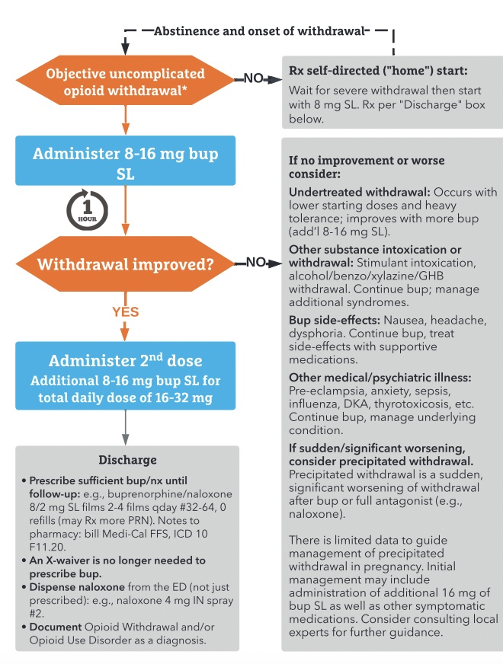

Slide 36
Buprenorphine inducted precipitated withdrawal
Together the partial agonism and high affinity have a downside when combined – buprenorphine-precipitated opioid withdrawal (BPOW).
If a standard dose of buprenorphine is given while someone has a full opioid agonist in their system, the buprenorphine replaces it.
This causes a sudden drop from full agonism to partial agonism and SEVERE abrupt opioid withdrawal.

Slide 37
Buprenorphine Precipitated withdrawal
While BPOW is not yet well defined in the literature it can be thought of as a rapid increase in Clinical Opioid Withdrawal Scale (COWS) >5-10 points along with objective signs of opioid withdrawal (e.g. diarrhea, vomiting, dilated pupils, severe restlessness) after being given buprenorphine.
To minimize the risk of BPOW, traditionally, buprenorphine is initiated first by waiting for signs of opioid withdrawal (e.g. COWS >8) to indicate there isn’t a significant full agonist on the receptor and then giving buprenorphine 2-4 mg, which is repeated until symptoms improve (SAMHSA TIP 63, 2021).

Slide 38
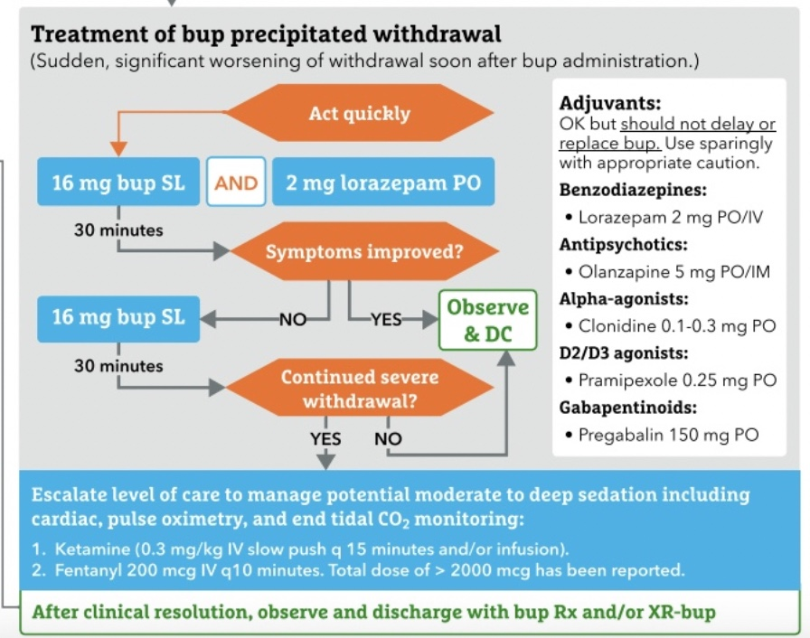

Slide 39
Methadone
Full opioid agonist with nearly 100% of the mu opioid receptor activated.
Because of this it can be started at anytime for a patient with OUD without causing precipitated withdrawal.
Highly effective for controlling withdrawal and cravings in patients using high potency Fentanyl analogs.
Once the patient is discharged from the hospital they can only obtain Methadone from a federally approved Opioid Treatment Program (methadone clinic).
Notes:
Use a "Methadone Checklist” to ensure your patient is a candidate for a methadone clinic: 1) Has OUD for at least 1 year, 2) Is geographically close to a clinic, 3) Has transportation to clinic, 4) Is at least 18 years old, and 5) Has a government issued photo ID.

Slide 40
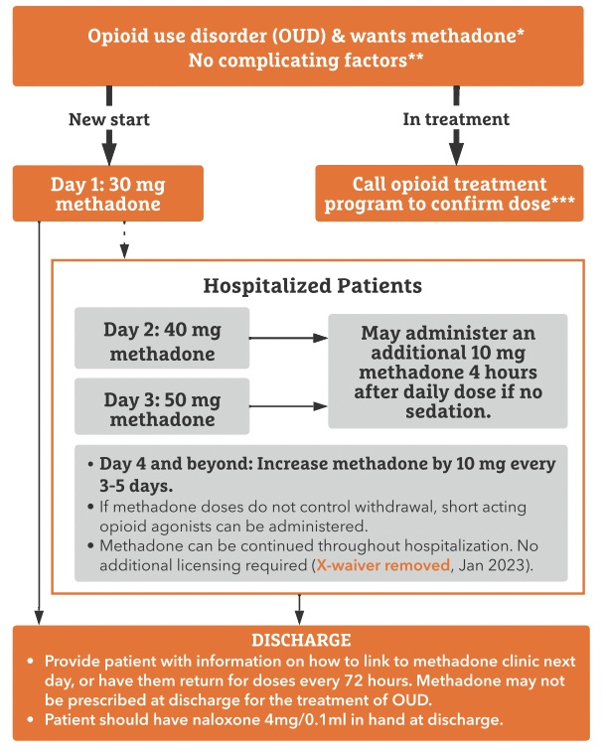

Slide 41
Contraindications for Methadone
RR <10
Low opioid tolerance
Allergy to methadone
Known QTc >500 msec (routine EKG before starting not needed)
Recent use of other sedating substances – benzodiazepines, alcohol, etc.
Severe liver disease
Medically unstable patients
Notes:
The risk of torsades de pointes is small. The risk of opioid overdose is high. Screening EKGs for patients without significant cardiac history, family history of sudden cardiac death, or known prolonged QTC should not limit methadone initiation or dosing (Clinical Practice Guidelines on Methadone Safety, 2014).
Expert opinion (Dr Potee) You can get a baseline EKG (although most OTPs don’t get screening EKGs when starting methadone), but there is no need for daily EKGs in a patient without other cardiac concerns. She reminds us to consider other QT prolonging medications such as fluoroquinolones, macrolides, TCAs, and certain SSRIs that may have an additive impact on a patient’s QT. These patients should have their EKGs monitored.

Slide 42
Multiple drug-drug interactions
STICKFACE.COM GROUP –inhibitors that increase methadone levels
Sodium Valproate, Ticlodipine, Isoniazid, Cimetidine Cardizem, Ketoconazole Fluoxetine Fluvoxamine, Alcohol (acute and binge), Cipro Chloramphenicol, Erythromycin, Sulfonamides, Cranberry juice, Omeprazole, Metronidazole, Grapefruit juice.
BS CRAP GPS inducers – decrease methadone levels
Barbiturates, St John’s Wort, Carbamazepine cigarettes, Rifampin, Alcohol chronic, Phenytoin, Griseofulvin, Phenobarbital Prednisone Pentazocine, Sulfonylureas.

Slide 43
Naltrexone
Naltrexone is an antagonist that is taken orally and is also available as a depo IM injection.
Naltrexone has no euphorigenic properties and does not result in tolerance or withdrawal.
This medication is often used as a component of abstinence-based recovery treatment.
Oral therapy is fraught with poor medication compliance, which is less of an issue with the IM formulation.
There is conflicting evidence regarding efficacy (as measured by treatment retention or mortality), especially when compared to buprenorphine and methadone.
Some studies even show increased mortality in patients with opioid use disorder who are taking naltrexone, but others do not.
Notes:
Naltrexone is only effective for promoting abstinence from opioids in its injectable, long-acting formulation (Krupitsky 2011), not in its daily, oral form.
Patients have lower retention in treatment with naltrexone compared to buprenorphine or methadone (Jarvis 2018), and evidence that naltrexone reduces the risk of overdose is lacking (Wakeman 2020, Larochelle, 2018).
This is partly due to the fact that people lose opioid tolerance while taking naltrexone since it is an antagonist, so the risk of overdose is high when someone stops the medicine and starts using opioids again.
Naltrexone initiation requires 1-2 weeks of total abstinence from opioids which requires many patients to go through opioid withdrawal.
This process is painful and challenging, even in the clinical trial setting (Lee 2018).

Slide 44
Stimulant Use disorder
Stimulants are a broad category ranging from caffeine to cathinone.
The most common clinical stimulants we encounter are cocaine and methamphetamine.
Notes:
Characteristics of those using stimulants.
Adults with limited income
On Medicaid
People who are uninsured
Lower education status
Males
Middle aged adults
People living in rural areas

Slide 45
Cocaine
Cocaine is a monoamine reuptake inhibitor that increases the concentration and prolongs the duration of dopamine, norepinephrine, and serotonin in the synaptic cleft.
Common effects include alertness, euphoria, and enhanced concentration.
Cocaine can be used intranasally (by insufflation), orally, intravenously, or by inhalation.
It is generally available as a powder (water soluble and thus better for injecting, intranasal use, etc.) or as a solid form known as crack cocaine that is more easily smoked (NIDA, 2022).
Notes:
Benzoylecgonine is the metabolite found on UDS.
East Coast and Northeast US.

Slide 46
Methamphetamine/amphetamines
Methamphetamine & amphetamines are also monoamine reuptake inhibitors but additionally promote efflux of the neurotransmitters into the synapse, resulting in a longer duration of action and much higher levels of dopamine in the brain compared to cocaine (NIDA, 2021).
Methamphetamine can be used intranasally (insufflated), smoked, or injected.
Less common routes of administration include swallowing (“parachuting”) or per rectum (“booty bumping,” “boofing” or “hooping”).
Notes:
More typical in the West Coast and Midwest US, but creeping eastward.

Slide 47
Why patients use stimulants
People may use stimulants to find pleasure (Lorvick 2012), enhance concentration, self-treat ADHD symptoms, offset the effects of other substances, enhance sexual activity, or ensure survival (for instance, unhoused people may use stimulants to stay awake and vigilant overnight).
People may use stimulants daily, intermittently, or in a binging pattern.
The reason for use often influences the pattern of use.

Slide 48
Overamping
The stimulant equivalent of an overdose but differs from opioid overdose in the sense that it is not an acute, well-defined event.
Instead, it refers to negative or uncomfortable symptoms of stimulant intoxication (Harding, 2022).
These symptoms can include anxiety, palpitations, hypertension, hyperthermia, paranoia, psychosis, seizures, and cardiovascular or cerebrovascular events (Ciccarone & Shoptaw, 2022).
It is important to ask patients what overamping means to them and what specific symptoms are causing discomfort.

Slide 49
Treating overamping
Treatment for mild overamping is supportive.
Symptoms in these cases may include anxiety, paranoia, or palpitations.
In these cases, treat conservatively by creating a quiet and comfortable place for the patient to rest and recover.
Minimize stimulation by dimming lights, applying cold compresses, and providing water.
It’s important to speak calmly and softly to de-escalate the situation and let them rest.

Slide 50
Treating overamping
In patients with more severe agitation or discomfort, low-dose benzodiazepines (e.g., lorazepam, midazolam) can help.
If possible, clarify what other drugs or sedating agents the patient has used that day, before administration.

Slide 51
Treating overamping
In patients presenting with frank psychosis, it can be challenging to distinguish stimulant intoxication from an underlying psychiatric condition.
In these cases, psychiatry should be consulted to develop a collaborative plan and determine the need for antipsychotics (Shoptaw 2009).

Slide 52
Treating overamping
In all situations of overamping, avoid restraints.
Restraints can upset patients, escalating the situation.
Can lead to rhabdomyolysis, renal injury, and death.

Slide 53
Stimulant withdrawal
Stimulant withdrawal is not medically dangerous, like withdrawal from alcohol or benzodiazepines, but causes people to feel lousy.
It can last for days to weeks and may result in the return to or compensatory use of other substances.
Common symptoms include dysphoria, fatigue, irritability, general discomfort, and an inability to perform everyday activities (Ciccarone & Shoptaw, 2022).

Slide 54
Treating stimulant use disorder
People who use stimulants often use other substances.
Be sure to ask patients if, how, and why they use additional substances.
People using stimulants may also have unknown drug exposures due to contamination of the drug supply, particularly with fentanyl (Ciccarone, 2021).
In British Columbia, up to 10% of stimulants contain fentanyl (CCSA, 2020).
Anyone using cocaine or methamphetamine should receive naloxone to prevent fatal opioid overdose!

Slide 55
Treating stimulant use disorder
Medical Comorbidities
Social Determinants of Health
Psychosocial Treatments (non-pharmacologic)
Pharmacologic Treatment Options
Harm Reduction

Slide 56
Treatment of stimulant use disorder
It is important to consider physical and psychological comorbidities as well as social determinants of health that contribute to a patient’s stimulant use.
Housing status is particularly important.
Psychosocial treatment
Contingency management
Cogitative behavioral therapy
Notes:
As Dr. Bach explained, “People use stimulants for specific reasons. And if we don’t understand those reasons, we’re barking up the wrong tree.”

Slide 57
Pharmacological therapy
No medications are approved by the FDA for stimulant use disorder.
Most published data comes from small trials that focus on abstinence as the outcome.
Most of these studies are underpowered with high dropout rates (>40%), which makes the literature challenging to interpret.
However, evidence suggests that a few medications can help in some contexts and are safe to use.

Slide 58
Pharmacological therapy
Mirtazapine
Naltrexone with Bupropion
Psychostimulants
Topiramate
Notes:
A study published in 2019 that included cisgender men and transgender women who have sex with men, treated with 30 mg of mirtazapine for 24 weeks in conjunction with counseling, showed a significant reduction in methamphetamine use (Coffin, 2020).
The ADAPT-2 trial was a large multisite trial that evaluated a combination of IM naltrexone every 3 weeks and bupropion 450 mg daily for treatment of methamphetamine use disorder. The study found significantly increased abstinence with this therapy with a number-needed-to-treat of 9 (Trivedi, 2021). An important caveat is that many people with stimulant use disorder also use opioids. Naltrexone is contraindicated in individuals who use opioids, including methadone or buprenorphine.
Editor Note: U.S. clinicians should note that expert opinion considers the prescription of psychostimulants solely to treat stimulant use disorder (i.e. in the absence of another established indication such as ADHD or narcolepsy) to be a violation of Federal Law. If an individual has a co-occurring ADHD diagnosis, it is ok to use psychostimulants to treat ADHD and it may also benefit the stimulant use disorder
There is discussion around prescribing slow-release psychostimulants (dextroamphetamine, amphetamine salts) for withdrawal symptoms and maintenance, in logic that mirrors the use of methadone or buprenorphine for opioid use disorder. Most studies have not demonstrated any change in outcomes. However, one meta-analysis that included all prescribed psychostimulants for cocaine or methamphetamines found higher rates of abstinence, with a number-needed-to-treat of 16 (Tardelli, 2020). The safety profile of these medications is generally good, although trials have excluded patients with significant cardiovascular or psychiatric disease.
For patients who use stimulants and have attention-deficit/hyperactivity disorder (ADHD), treating ADHD with psychostimulants may alleviate the need for non-prescription stimulants (Levin, 2018).
The evidence for topiramate is mixed and primarily focuses on cocaine use disorder. A recent study investigating topiramate (titrated to 150 mg twice daily) combined with amphetamine salts found higher rates of three consecutive weeks of abstinence than placebo over 12 weeks (Levin, 2012).

Slide 59
Harm reduction
Discuss harm reduction for stimulant use with patients, especially if abstinence is not their goal.
Harm reduction includes considering safer routes of administration based on a patient’s comorbidities
e.g. avoid inhalation in a patient with COPD.
Safer use of equipment (e.g. discuss that hepatitis C can be transmitted from sharing pipes).
Provision of naloxone for overdose prevention.

Slide 60
Harm reduction
Patients should be encouraged to use with people rather than alone, avoid sharing supplies, and test drug supplies with a small starting dose.
Refer patients to additional resources including
Overdose prevention centers
Local syringe exchange programs
Never use alone hotline
Patient handouts available for free online

Slide 61
Nitazines
Novel Opioids: Nitazines
Brorphine
Para fluoro fentanyl
Developed in 1950s for pain and anesthesia
Up to 40x stronger than fentanyl
Multiple doses of naloxone

Slide 62
Pitfalls of treating OUD in the ed
Failure to screen for co-ingestions, other substance abuse disorders, or unstable psychiatric disease.
Failure to screen for trauma or medical complications of abuse.
Failure to prescribe naloxone when clinically indicated.

Slide 63
Pitfalls
Oxycodone may be the most abuse-prone opioid due to its rapid active transport across the blood brain barrier and enhanced effects in mesolimbic dopamine signaling.
In a recent survey-based study of opioid dependent patients, oxycodone was rated the most desirable and most addictive by 86 patients who met the criteria for opioid use disorder.
Consider using immediate release morphine for pain control at home.

Slide 64
Summery
MOUD is totally doable in the ED.
MOUD saves lives, reduces harm, decreases health care costs.
Don’t forget to prescribe Naloxone to patients with OUD or those you are prescribing opioids.

Slide 65
Questions?
Recourses:
California Bridge Treatment Protocols bridgetotreatment.org
Curb Siders Addiction Medicine Podcast
EM:RAP CorePendium
The Addiction Files Podcast
Addiction Medicine Made Easy with Casey Grover, MD Podcast

Slide 66
Sources
Extended-Release 7-Day Injectable Buprenorphine for Patients With Minimal to Mild Opioid Withdrawal Gail D’Onofrio, MD; Andrew A. Herring, MD; Jeanmarie Perrone, MD; Kathryn Hawk, MD; Elizabeth A. Samuels, MD; Ethan Cowan, MD; Erik Anderson, MD; Ryan McCormack, MD; Kristen Huntley, PhD; Patricia Owens, MS; Shara Martel, MPH; Mark Schactman, MHS; Michele R. Lofwall, MD; Sharon L. Walsh, PhD; James Dziura, PhD; David A. Fiellin, MD
“It’s called overamping”: experiences of overdose among people who use methamphetamine Robert W. Harding1 , Katherine T. Wagner2 , Phillip Fiuty3 , Krysti P. Smith1 , Kimberly Page2 and Karla D. Wagner1, Harding et al. Harm Reduction Journal (2022) 19:4 https://doi.org/10.1186/s12954-022-00588-7
Opioid Use Disorder and Dependence, Core Pendium EMRAP.ORG AuthorDavid Black, MD, Section EditorManpreet Singh, MD, Associate EditorSean Patrick Nordt, MD, PharmD, Editors in ChiefAmal Mattu, MD, Stuart Swadron, MD, Sean Patrick Nordt, MD, PharmD, Whitney Johnson, MD, MS
Huxley-Reicher Z, Bach, P, Stahl, N, Mullins, K, Morford K, Chan, CA, “#5 Amp Up Your Treatment of Stimulant Use Disorder with Dr. Paxton Bach”. The Curbsiders Addiction Medicine Podcast. http://thecurbsiders.com/addiction August 4th, 2022.
Kryzhanovskaya E, Sokolski E, Goff A, Leyde S, Chan CA “#22 Low Key Pearls for Low Dose Bup with Dr. Sokoloski and Amelia Goff, FNP”. The Curbsiders Addiction Medicine Podcast. https://thecurbsiders.com/addiction September 19th, 2023
Mullins K, Terplan M, Sonoda K, Chan CA. “#13 Opioid Use Disorder in Pregnancy with Dr. Miska Terplan”. The Curbsiders Addiction Medicine Podcast. https://thecurbsiders.com/addiction July 13th, 2023.

Slide 67
Sources
Potee, R, Morford, K, Watto MF, Huxley-Reicher Z, Cohen S, Chan CA “#1 Methadone for Opioid Use Disorder – Find your Rage with Dr. Ruth Potee”. The Curbsiders Addiction Medicine Podcast. http://thecurbsiders.com/episode-list Julu 7th, 2022.
Cohen S, Soran C, Mullins K, Chan CA “#7 Do the OBOT: Buprenorphine for OUD in the Clinic with Dr. Christine Soran”. The Curbsiders Addiction Medicine Podcast. http://thecurbsiders.com/addiction 8/18/2022
https://bridgetotreatment.org/wp-content/uploads/protocol-packet.pdf - Emergency Department Buprenorphine Quick start, Buprenorphine immediately after opioid overdose reversal with Naloxone, Buprenorphine quick start in pregnancy, Methadone hospital quick start.

