Slide 1
AHCCCS Substance Use Strategies,
Including Expanding ED Naloxone Distribution Efforts
Sara Salek, M.D., Chief Medical Officer
November 8, 2023

Slide 2
AHCCCS Substance Use Strategies
Primary prevention
Stigma reduction/public education
Naloxone, naloxone, naloxone
Practitioner education
Identification and navigation to evidence based treatment
Recovery/Peer Support
MAT

Slide 3
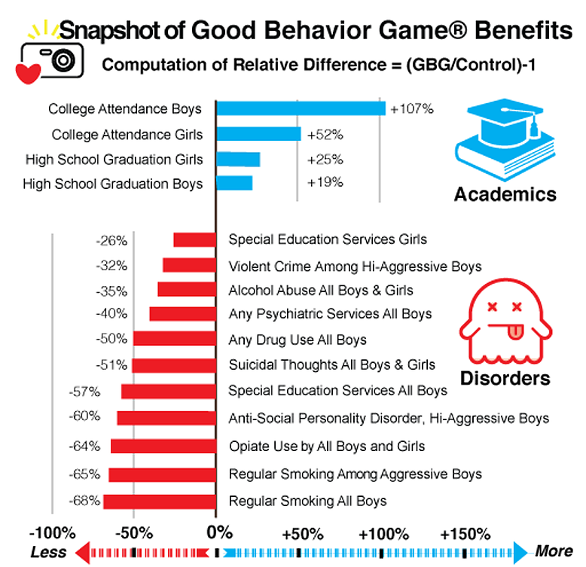
Prevention—PAX GBG

Slide 5
Substance Abuse Coalition Leaders of Arizona (SACLAz) Toolkits

Slide 6
MAT Mentor Program
UA Center for Rural Health MAT Mentor program pairs experienced and new MAT providers
Provides guidance to new or inexperienced providers to increase their capacity for providing medication-assistance treatment (MAT) services in Arizona.
https://crh.arizona.edu/mentor

Slide 7
Hushabye Nursery
Nursery with detoxification services for substance exposed newborns (SENs)
Implementation of the Eat, Sleep, Console method, increasing baby-parent bonding, parenting skills, reducing need for removal from family, and reducing the need for methadone administration in newborns
Outpatient treatment for parents of SENs, outreach and women’s services, peer support services, family coaching

Slide 8
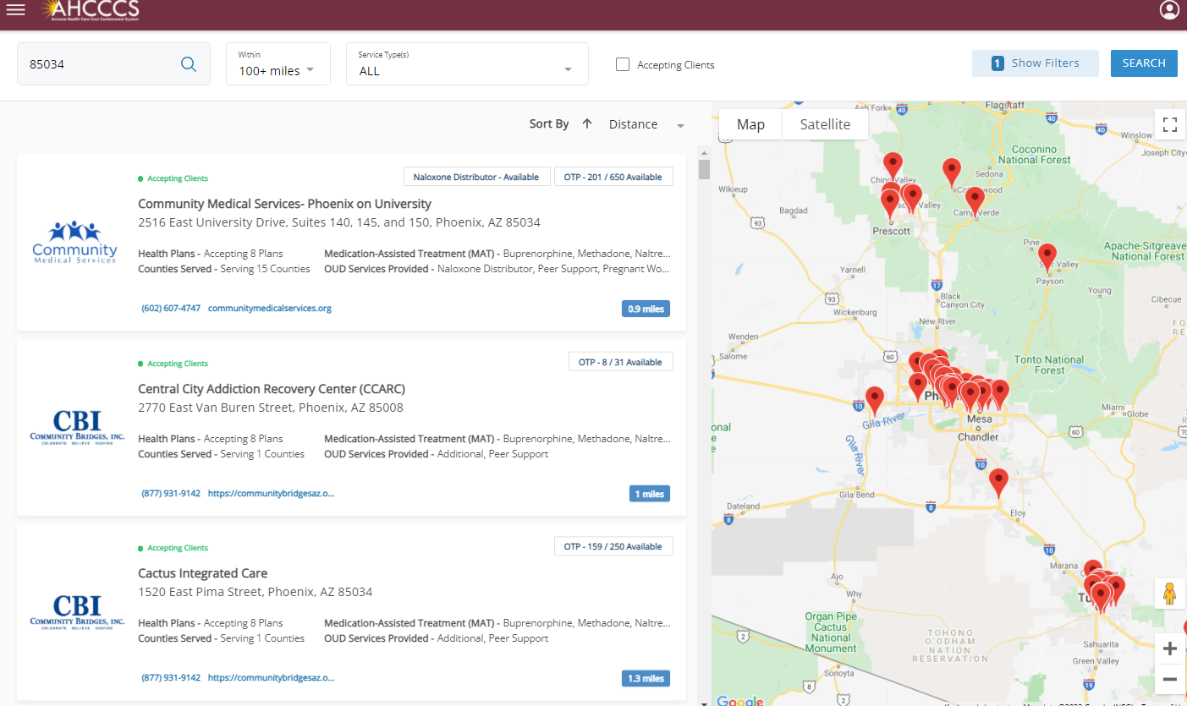
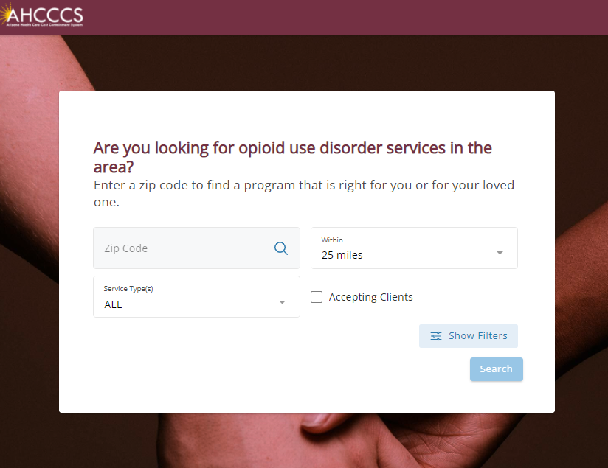
Opioid Use Disorder Services Locator
opioidservicelocator.azahcccs.gov/
Notes:
Owner: Bianca Arriaga
https://opioidservicelocator.azahcccs.gov/
Use the real-time opioid services locator at opioidservicelocator.azahcccs.gov to find providers who are available to treat Opioid Use Disorder.
Find providers by service type, health care plan, county, or zip code.

Slide 9
24/7 Access Points
Provider | Address | Phone Number
CODAC Health, Recovery and Wellness | 380 E. Ft. Lowell Road, Tucson, AZ 85705 | 520-202-1786
Community Bridges, East Valley Addiction Recovery Center | 560 S. Bellview, Mesa, AZ 85204 | 480-461-1711
Community Medical Services | 2806 W. Cactus Road, Phoenix, AZ 85029 | 602-607-7000
Intensive Treatment Systems, West Clinic | 4136 N. 75th Ave #116 Phoenix, AZ 85033 | 623-247-1234

Slide 10
NDP CYE 24 Differential Adjusted Payment (DAP)
The Naloxone Distribution Program (NDP) DAP provides an incentive increase to AHCCCS rates for Emergency Departments that develop a facility NDP policy and begin Naloxone distribution.
The NDP DAP is directed to the following providers:
Hospitals with an Emergency Department
Critical Access Hospitals with an Emergency Department
IHS and 638 Tribally Owned and/or Operated Facilities with an Emergency Department
Freestanding Emergency Departments

Slide 11
Hospitals/EDs Participating in FFY24 NDP DAP
Deer Valley Medical Center
Douglas Emergency Department
Flagstaff Medical Center
Havasu Regional Medical Center
Holy Cross Hospital
Holy Cross Hospital
HonorHealth Complete Care
HonorHealth Scottsdale
HonorHealth Sonoran Cross
IHS Chinle Hospital
John C Lincoln Medical Center
Kingman Regional Medical Center
La Paz Regional Hospital
Mt Graham Regional Medical Center
Northern Arizona Healthcare
Northern Cochise Hospital
Northwest Medical Center
Oro Valley Hospital
Phoenix Children's Hospital
Scottsdale HealthCare- Osborn
Scottsdale HealthCare- Shea
St. Joseph's Hospital and Medical Center
St. Joseph's Hospital- Tucson
St. Joseph's Westgate Medical Center
Summit Healthcare Regional Hospital
Tucson Medical Center
Valley View Medical Center
Valleywise Health Medical Center
Verde Valley Medical Center
Western Arizona Regional Medical Center
White Mountain Regional Medical Center
Abrazo Arizona Heart Hospital
Abrazo Arrowhead Campus
Abrazo Buckeye ED
Abrazo Cave Creek
Abrazo Central Campus
Abrazo Peoria ED
Abrazo Scottsdale Campus
Abrazo Surprise Hospital
Abrazo West Campus
Banner Baywood
Banner Boswell
Banner Casa Grande
Banner Del E. Webb
Banner Desert
Banner Estrella
Banner Gateway
Banner Goldfield
Banner Heart Hospital
Banner Ironwood
Banner Ocotillo
Banner Payson Medical Center
Banner Thunderbird
Banner University Medical- Phoenix
Banner University Medical- South Tucson
Banner University Medical- Tucson
Benson Hospital
Canyon Vista Medical Center
Carondelet St. Mary's Hospital
Carondelet St. Rafel's Emergency
Carondelet Marana Hospital
Copper Queen Hospital

Slide 12
Resources
CYE 2024 DAP Final Public Notice: https://www.azahcccs.gov/AHCCCS/Downloads/PublicNotices/rates/CYE24_DAP_Notice.pdf
Naloxone Distribution Program Policy Standards: https://www.azahcccs.gov/AHCCCS/Downloads/PublicNotices/rates/NaloxoneDistributionProgramPolicyStandards.pdf
Naloxone Distribution Program Policy Checklist: https://www.azahcccs.gov/AHCCCS/Downloads/PublicNotices/rates/NDPPolicyChecklist.xlsx
Questions? Email AHCCCSDAP@azahcccs.gov.

